Slide 1
BITS Pilani
Dr. Lavika Goel
Assistant Professor
Department of CSIS
Lecture 8: 16/3/2019
Pilani Campus

Slide 2
Exercise 1
Given below is the Similarity matrix (Note : Similarity and not Distance) for 5 documents. If Single Link Hierarchical Clustering is used , what is the resultant dendrogram and the corresponding similarity measure?
 | D1 | D2 | D3 | D4 | D5
D1 | 1.00 | 0.10 | 0.41 | 0.52 | 0.35
D2 |  | 1.00 | 0.64 | 0.47 | 0.86
D3 |  |  | 1.00 | 0.44 | 0.80
D4 |  |  |  | 1.00 | 0.76
D5 |  |  |  |  | 1.00
3/13/2019 SS ZG537 (INFORMATION RETRIEVAL) 2

Slide 3
Exercise 1
The highest similarity is between D2 and D5 ----- 0.86
The next highest is D3, D5 --- 0.80
The second cluster is (D2,D5,D3) with similarity 0.80
The next highest is D4 – 0.76
The third cluster is (D2,D5,D3,D4) with similarity 0.76
The final cluster is (D1,D2,D3,D4,D5) with similarity 0.52
3/13/2019 SS ZG537 (INFORMATION RETRIEVAL) 3

Slide 4
Exercise 2
Given below is the Similarity matrix (Note : Similarity and not Distance) for 5 documents. If Complete Link Hierarchical Clustering is used , what is the resultant dendrogram and the corresponding similarity measure?
 | D1 | D2 | D3 | D4 | D5
D1 | 1.00 | 0.10 | 0.41 | 0.52 | 0.35
D2 |  | 1.00 | 0.64 | 0.47 | 0.86
D3 |  |  | 1.00 | 0.44 | 0.80
D4 |  |  |  | 1.00 | 0.76
D5 |  |  |  |  | 1.00
3/13/2019 SS ZG537 (INFORMATION RETRIEVAL) 4

Slide 5
Exercise 2
The highest similarity is between D2 and D5 ----- 0.86
The first cluster is (D2,D5) with similarity 0.86
The similarity of other clusters is compared with first cluster.
Sim({D2,D5} , {D3}) = min(sim(2,3),sim(3,5)
= min(0.64,0.80) = 0.64
Sim({D2,D5} , {D1}) = min(sim(2,1),sim(1,5)
= min(0.1,0.35) = 0.1
Sim({D2,D5} , {D4}) = min(sim(2,4),sim(4,5)
= min(0.47,0.76) = 0.47
Sim(D1,D4)= 0.52
Sim(D1,D3)= 0.41
Sim(D3,D4)= 0.44
The second cluster with highest similarity is ({D2,D5}, {D3}) - 0.64
The third cluster with highest similarity is (D1,D4) – 0.52
The final cluster is (D1,D4) combined with (D2,D3,D5) and the minimum similarity is 0.10 which is final cluster similarity
3/13/2019 SS ZG537 (INFORMATION RETRIEVAL) 5

Slide 6
Today’s agenda
Web search basics
Web Crawling
Crawling
Crawler Architecture
Distributed Indexes
Web Graph
Page Rank
Simple Example
3/13/2019 SS ZG537 (INFORMATION RETRIEVAL) 6
Pilani Campus

Slide 7
Background – Web search
Why Web search is more complex than IR
Scale (about 20 billions pages currently)
Lack of coordination (decentralized content publishing, lots of duplicates)
Heterogeneity of its contributors (motives and backgrounds, lots of spam – need to detect spam)
3/13/2019 SS ZG537 (INFORMATION RETRIEVAL) 7
Pilani Campus

Slide 8
Background – Web search
Early web search engines and web collections
Full-text index-based search engines (altavista, excite, Infoseek)
Taxonomy-based search engines (yahoo)
relies on a classification of documents that may be unintuitive, and has a high cost of maintenance
Early collections:
Tens of millions pages (larger than any prior collection)
indexing and fast querying performed successfully, without the expected quality of retrieval
new techniques were needed to rank the retrieved pages and deal with the spams
3/13/2019 SS ZG537 (INFORMATION RETRIEVAL) 8
Pilani Campus

Slide 9
Indexing the web
Questions on indexing the web:
Which pages can one trust ?
How a search engine can assign a measure of trust to a webpage ?
How to deal with the expansion of the collection ?
• How to deal with redundancy ?
3/13/2019 SS ZG537 (INFORMATION RETRIEVAL) 9
Pilani Campus

Slide 10
Ads and Web Search
Earlier Technique- branding
Companies used graphical banner advertisements on web pages at popular websites (news and entertainment sites such as MSN, America Online, Yahoo! and CNN).
Cost Per Mil (CPM) basis: the CPM cost to the company of having its banner advertisement displayed 1000 times.
The other pricing model is CPC known as the cost per click (CPC) model.
3/13/2019 SS ZG537 (INFORMATION RETRIEVAL) 10
Pilani Campus

Slide 11
Ads and Web Search
First generation of search ads: Goto (1996)
Pages were simply ranked according to bid – revenue maximization for Goto.
No separation of ads/docs. Only one result list!
Upfront and honest. No relevance ranking, but Goto did not pretend there was any.
Second generation of search ads: Google (2000/2001)
Strict separation of search results and search ads
3/13/2019 SS ZG537 (INFORMATION RETRIEVAL) 11
Pilani Campus

Slide 12
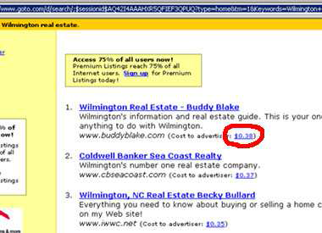
Ads and Web Search
3/13/2019 SS ZG537 (INFORMATION RETRIEVAL) 12
Pilani Campus

Slide 13
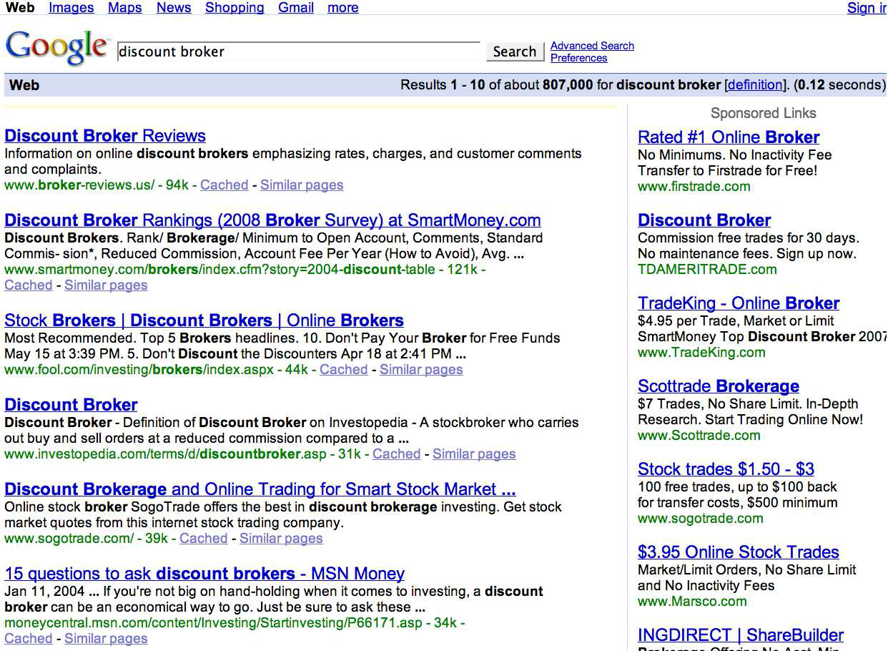
Two ranked lists: web pages and ads
SogoTrade appears in search results.
SogoTrade appears in ads.
Do search engines rank advertisers higher than non-advertisers?
All major search engines claim no.
3/13/2019 SS ZG537 (INFORMATION RETRIEVAL) 13
Pilani Campus

Slide 14
Ads and Web Search
Current search engines follow precisely this model: they provide pure search results ALGORITHMIC SEARCH (generally known as algorithmic search results) as the primary response to a user’s search, together with sponsored search results displayed separately and distinctively to the right of the algorithmic results
3/13/2019 SS ZG537 (INFORMATION RETRIEVAL) 14
Pilani Campus

Slide 15
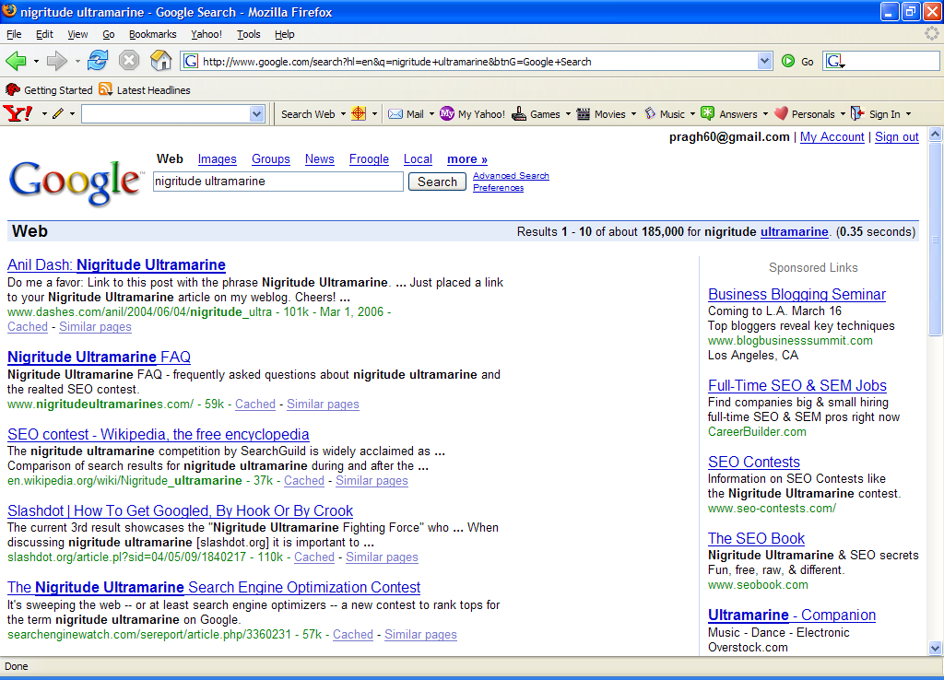
Paid
Search Ads
Algorithmic results.
3/13/2019 SS ZG537 (INFORMATION RETRIEVAL) 15

Slide 16
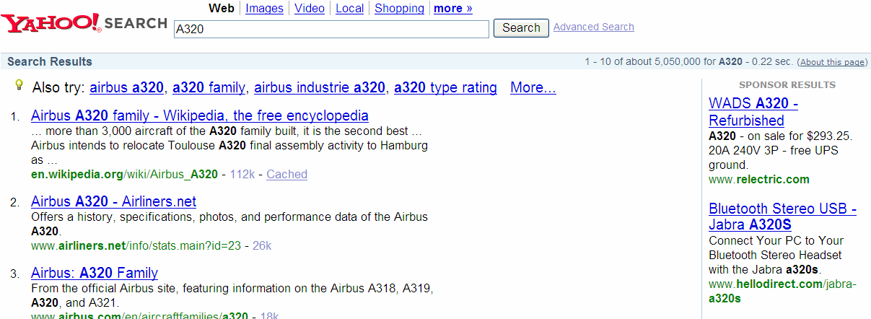
Ads and Web Search
3/13/2019 SS ZG537 (INFORMATION RETRIEVAL) 16
Pilani Campus

Slide 17
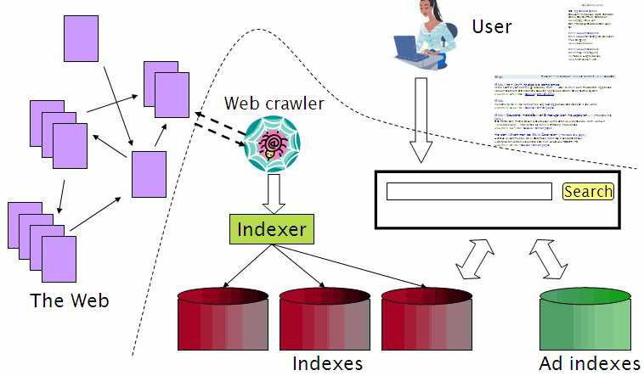
Web Search
3/13/2019 SS ZG537 (INFORMATION RETRIEVAL) 17
Pilani Campus

Slide 18
Web IR: Differences from traditional IR
Links: The web is a hyperlinked document collection.
Queries: Web queries are different, more varied and there are a lot of them. How many? ≈ 10⁹
Users: Users are different, more varied and there are a lot of them. How many? ≈ 10⁹
Documents: Documents are different, more varied and there are a lot of them. How many? ≈ 10¹¹
Context: Context is more important on the web than in many other IR applications.
Ads and spam
3/13/2019 SS ZG537 (INFORMATION RETRIEVAL) 18
Pilani Campus

Slide 19
User Needs in Web search
There are three broad categories into which common web search queries can be grouped:
informational
navigational
transactional.
3/13/2019 SS ZG537 (INFORMATION RETRIEVAL) 19
Pilani Campus

Slide 20
User Needs in Web search
Informational
want to learn about something
Navigational
want to go to that page
Transactional
want to do something (web-mediated)
Access a service
Downloads
Shop
Low hemoglobin
United Airlines
Seattle weather
Mars surface images
Canon S410
3/13/2019 SS ZG537 (INFORMATION RETRIEVAL) 20
Pilani Campus

Slide 21
Web Crawling
Gathering pages from the internet, in order to index them
Objectives
fast gathering
efficient gathering (as many useful web pages as possible, and the links interconnecting them)
Focus on issues arising when developing a web crawler
3/13/2019 SS ZG537 (INFORMATION RETRIEVAL) 21
Pilani Campus

Slide 22
Features a Crawler
Must Provide
Robustness:
Be immune to spider traps, duplicates, very large pages, very large websites, dynamic pages etc.
Politeness:
Explicit politeness: specifications from webmasters on what portions of site can be crawled : robots.txt
Implicit politeness: even with no specification, avoid hitting any site too often
3/13/2019 SS ZG537 (INFORMATION RETRIEVAL) 22
Pilani Campus

Slide 23
Features a Crawler
Should Provide
Distribution: crawling should be distributed within several machines
Scalability: crawling should be extensible by adding machines, extending bandwidth, etc.
Efficiency: clever use of the processor, memory, bandwidth (e.g. as few idle processes as possible)
Quality: should detect the most useful pages, to be indexed first
Freshness: should continuously crawl the web (visiting frequency of a page should be close to its modification frequency)
Extensibility: should support new data formats (e.g. XML-based formats), new protocols (e.g. ftp), etc.
3/13/2019 SS ZG537 (INFORMATION RETRIEVAL) 23
Pilani Campus

Slide 24
Crawler operation
Initialize queue with URLs of known seed pages
Repeat
Take URL from queue
Fetch and parse page
Extract URLs from page
Add URLs to queue
Fundamental assumption: The web is well linked.
3/13/2019 SS ZG537 (INFORMATION RETRIEVAL) 24
Pilani Campus

Slide 25
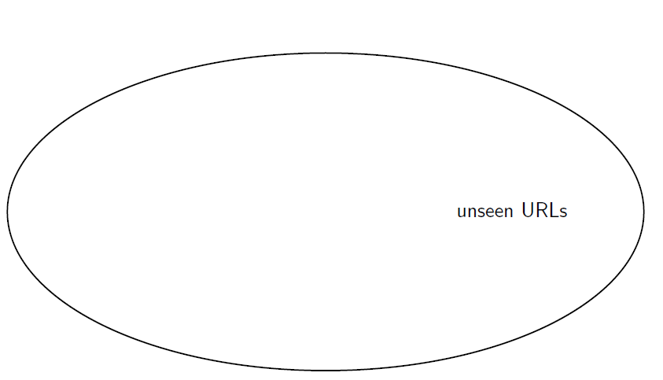
Crawling
3/13/2019 SS ZG537 (INFORMATION RETRIEVAL) 25
Pilani Campus

Slide 26
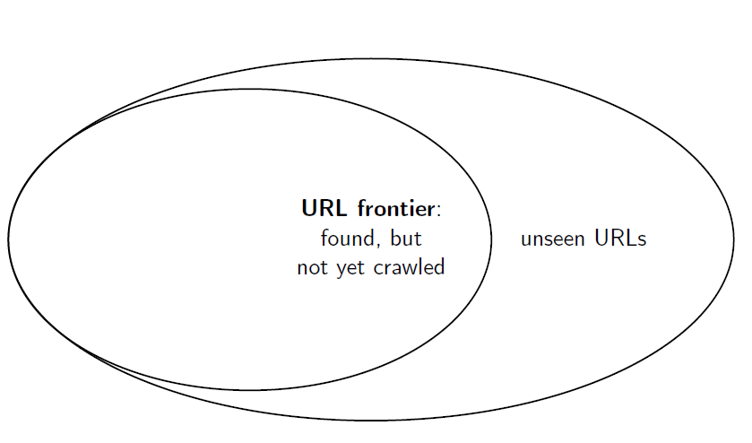
Crawling
3/13/2019 SS ZG537 (INFORMATION RETRIEVAL) 26
Pilani Campus

Slide 27
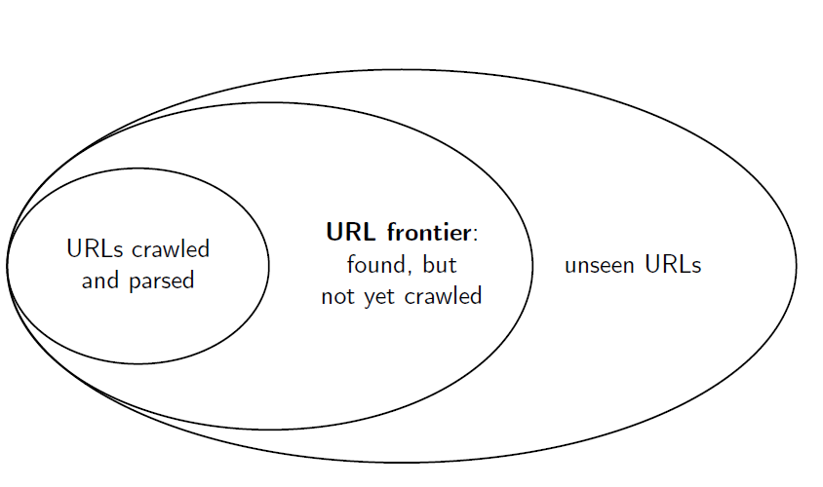
Crawling
3/13/2019 SS ZG537 (INFORMATION RETRIEVAL) 27
Pilani Campus

Slide 28
Crawling
URLs crawled
and parsed
Unseen Web
Seed
Pages
URL frontier
Crawling thread
3/13/2019 SS ZG537 (INFORMATION RETRIEVAL) 28
Pilani Campus

Slide 29
Crawling process
Pick a URL from the frontier
Fetch the document at the URL
Parse the URL
Extract links from it to other docs (URLs)
Check if URL has content already seen
If not, add to indexes
For each extracted URL
Ensure it passes certain URL filter tests
Check if it is already in the frontier (duplicate URL elimination)
E.g., only crawl .edu, obey robots.txt, etc.
3/13/2019 SS ZG537 (INFORMATION RETRIEVAL) 29
Pilani Campus

Slide 30
Crawling process
Reference point: fetching a billion pages in a month-long crawl requires fetching several hundred pages each second
Some potential issues:
Links encountered during parsing may be relative paths
normalization needed
Pages of a given web site may contain several duplicated links
Some links may point to robot-free areas
3/13/2019 SS ZG537 (INFORMATION RETRIEVAL) 30
Pilani Campus

Slide 31
Crawling process in Detail
A crawler thread begins by taking a URL from the frontier and fetching the web page at that URL, generally using the http protocol.
The fetched page is parsed and the text as well as the links in it are extracted.
The text (with HTML tags) is passed on to the indexer
Link information including anchor text is passed on to the indexer for use in ranking.
3/13/2019 SS ZG537 (INFORMATION RETRIEVAL) 31
Pilani Campus

Slide 32
Crawling process in Detail
Each extracted link goes through a series of tests to determine whether the link should be added to the URL frontier.
Content seen
URL filter
Duplicate elimination
3/13/2019 SS ZG537 (INFORMATION RETRIEVAL) 32
Pilani Campus

Slide 33
Duplicate URL elimination
if the URL is already in the frontier or (in the case of a non-continuous crawl) already crawled, we do not add it to the frontier. When the URL is added to the frontier, it is
assigned a priority based on which it is eventually removed from the frontier for fetching.
3/13/2019 SS ZG537 (INFORMATION RETRIEVAL) 33
Pilani Campus

Slide 34
Architecture of a crawler
URL frontier – managing the URLs to be fetched
DNS resolution – determining the host (web server) from which to fetch a page defined by a URL
Fetching module – downloading a remote webpage for processing
Parsing module – extracting text and links
Duplicate elimination – detecting URLs and contents that have been processed a short time ago
3/13/2019 SS ZG537 (INFORMATION RETRIEVAL) 34
Pilani Campus

Slide 35
Basic Crawler architecture
WWW
DNS
Doc
FP’s
robots
filters
URL
set
Parse
Fetch
Content
seen?
URL
filter
Dup
URL
elim
URL Frontier
3/13/2019 SS ZG537 (INFORMATION RETRIEVAL) 35
Pilani Campus

Slide 36
Pilani Campus
The Google Page-rank Algorithm and HITS

Slide 37
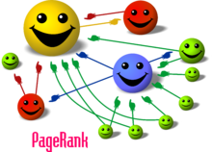
Web Graph
3/13/2019 SS ZG537 (INFORMATION RETRIEVAL) 37
Pilani Campus

Slide 38
Page Rank
PageRank is an algorithm used by Google Search to rank websites in their search engine results.
PageRank was named after Larry Page, one of the founders of Google.
PageRank is a way of measuring the importance of website pages.
In short PageRank is a “vote”, by all the other pages on the Web, about how important a page is.
A link to a page counts as a vote of support
PR(A) = (1-d) + d(PR(T1)/C(T1) +…+PR(Tn)/C(Tn))
3/13/2019 SS ZG537 (INFORMATION RETRIEVAL) 38
Pilani Campus

Slide 39
Page Rank
PageRank is a probability distribution used to represent the likelihood that a person randomly clicking on links will arrive at any particular page.
PageRank can be calculated for collections of documents of any size.
It is assumed in several research papers that the distribution is evenly divided among all documents in the collection at the beginning of the computational process.
3/13/2019 SS ZG537 (INFORMATION RETRIEVAL) 39
Pilani Campus
Notes:
A probability is expressed as a numeric value between 0 and 1.
A 0.5 probability is commonly expressed as a "50% chance" of something happening.
Hence, a PageRank of 0.5 means there is a 50% chance that a person clicking on a random link will be directed to the document with the 0.5 PageRank.

Slide 40
Page rank
Page rank of a page P is the sum of links that point to P.
If there is one link pointing to P then the PR(P) = 1
If there is two links pointing to P then the PR(P) = 2 …
The probability of the user landing on page P based on the pages that point to P (step 1)
PR(P) = Σ links points to P
3/13/2019 SS ZG537 (INFORMATION RETRIEVAL) 40
Pilani Campus

Slide 41
Page Rank
Step 2
Assume a random walker and assume that there is a single path from Page A to P then he is more likely to reach P rather than any pages.
The number of out going links from a page decreases if this number is high so divide this by the number of outgoing links
PR(P) = Σ links points to P / L(P_{i})
Number of out going links from P_{i}
P_{i}
P
3/13/2019 SS ZG537 (INFORMATION RETRIEVAL) 41
Pilani Campus

Slide 42
Page Rank
Step 3:
Page P is more likely to be reached if there is a link from a page that has a big page rank(i.e there is a high probability of reaching this page)
Page rank of a page P is the sum of the page ranks of the page P_{i} that have a path to P divided by the out going links from P_{i}
PR(P) = Σ PR(P_{i}) / L(P_{i})
3/13/2019 SS ZG537 (INFORMATION RETRIEVAL) 42
Pilani Campus

Slide 43
Page Rank
Step 4: Random walker can move from one page to the other this model is captured by the Damping factor.
Ability of the random walker to go any where is evaluated as per existing web documents and the value is 0.85 (i.e after every six pages that will reach to a path.
N is total number of pages
1 = (1-d) / N + d Σ PR(P_{i}) / L(P_{i})
i.e Probability distribution
3/13/2019 SS ZG537 (INFORMATION RETRIEVAL) 43
Pilani Campus

Slide 44
Two formula as per literature
PR(A) = (1-d) + d(PR(T₁)/L(T₁) +…+PR(T_{n})/L(T_{n}))
PR(A) = (1-d)/N + d(PR(T₁)/L(T₁) +…+PR(T_{n})/L(T_{n}))
Where T₁,T₂…T_{n} are pages that are pointing to A.
3/13/2019 SS ZG537 (INFORMATION RETRIEVAL) 44
Pilani Campus

Slide 45
How is it Calculated?
The PR of each page depends on the PR of the pages pointing to it.
But we won’t know what PR those pages have until the pages pointing to them have their PR calculated and so on.
So what we do is make a guess.
3/13/2019 SS ZG537 (INFORMATION RETRIEVAL) 45
Pilani Campus

Slide 46

Simple Example
Each page has one outgoing link. So that means L(A) = 1 and L(B) = 1.
3/13/2019 SS ZG537 (INFORMATION RETRIEVAL) 46
Pilani Campus

Slide 47
We don’t know what their PR should be to begin with, so we will just guess 0 and 1.
d (damping factor) = 0.85
PR(A)= (1 – d) + d(PR(B)/1)
PR(B)= (1 – d) + d(PR(A)/1)
3/13/2019 SS ZG537 (INFORMATION RETRIEVAL) 47
Pilani Campus

Slide 48
PR(A)= 0.15 + 0.85 * 0 = 0.15
= 0.15 + 0.85 * 1 PR(B)= 1
Now we have calculated a “next best guess” so we just plug it in the equation again…
PR(A)= 0.15 + 0.85 *1 = 1
PR(B)= 0.15 + 0.85 * 0.15 = 0.2775
And again…
PR(A)= 0.15 + 0.85 * 0.2775 = 0.385875
PR(B)= 0.15 + 0.85 * 1 = 1
3/13/2019 SS ZG537 (INFORMATION RETRIEVAL) 48
Pilani Campus

Slide 49
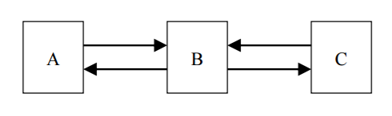
Example
3/13/2019 SS ZG537 (INFORMATION RETRIEVAL) 49
Pilani Campus

Slide 50
(Contd..)
The number of web pages N = 3.
Consider the damping parameter d = 0.7. (Consider the page rank calculations by the second formula.)
PR(A) = (1 – d) × ( 1 / N ) + d × ( PR(B) / 2 )
PR(B) = (1 – d) × ( 1 / N ) + d × ( PR(A) / 1 + PR(C) / 1 )
PR(C) = (1 – d) × ( 1 / N ) + d × ( PR(B) / 2 )
So PR(A) = 0.1 + 0.35 × PR(B)
PR(B) = 0.1 + 0.70 × PR(A) + 0.70 × PR(C)
PR(C) = 0.1 + 0.35 × PR(B)
By solving the above system of linear equations, we get
PR(A) = 0.2647
PR(B) = 0.4706
PR(C) = 0.2647.
3/13/2019 SS ZG537 (INFORMATION RETRIEVAL) 50
Pilani Campus

Slide 51
Principle
It doesn’t matter where you start your guess, once the PageRank calculations have settled down, the “normalized probability distribution” (the average PageRank for all pages) will be 1.0
3/13/2019 SS ZG537 (INFORMATION RETRIEVAL) 51
Pilani Campus

Slide 52
HITS: Hubs and Authorities
3/13/2019 SS ZG537 (INFORMATION RETRIEVAL) 52
Pilani Campus

Slide 53
HITS – Hyperlink-Induced Topic Search
There are two different types of relevance on the web.
Hubs: A hub page is a good list of links to pages answering the information need.
E.g., for query [chicago bulls]: Alice’s list of recommended resources on the Chicago Bulls sports team
Authorities: An authority page is a direct answer to the information need.
The home page of the Chicago Bulls sports team
By definition: Links to authority pages occur repeatedly on hub pages.
3/13/2019 SS ZG537 (INFORMATION RETRIEVAL) 53
Pilani Campus

Slide 54
Hubs and authorities: Definition
A good hub page for a topic links to many authority pages for that topic.
A good authority page for a topic is linked to by many hub pages for that topic.
Appear to have a circular definition of hubs and authorities; we will turn this into an iterative computation
3/13/2019 SS ZG537 (INFORMATION RETRIEVAL) 54
Pilani Campus

Slide 55
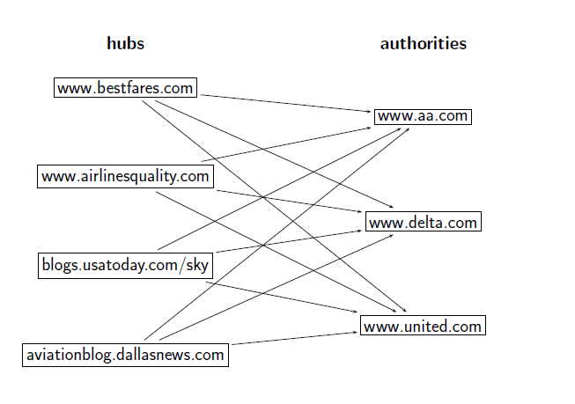
Example
3/13/2019 SS ZG537 (INFORMATION RETRIEVAL) 55
Pilani Campus

Slide 56
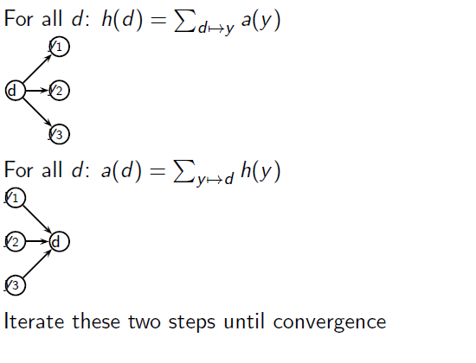
Hub and authority scores
3/13/2019 SS ZG537 (INFORMATION RETRIEVAL) 56
Pilani Campus

Slide 57
Hub and authority scores
Compute for each page d, a hub score h(d) and an authority score a(d)
Initialization: for all d: h(d) = 1, a(d) = 1
Iteratively update all h(d), a(d)
After convergence:
Output pages with highest h scores as top hubs
Output pages with highest a scores as top authorities
So we output two ranked lists
3/13/2019 SS ZG537 (INFORMATION RETRIEVAL) 57
Pilani Campus

Slide 58
Exercise
A
B
C
D
Consider the Web Graph given above. Run the Hubs and Authorities algorithms on this Web graph of pages. Show the authority and hub scores for each page for the first two iterations.
3/13/2019 SS ZG537 (INFORMATION RETRIEVAL) 58
Pilani Campus

Slide 59
 | A | B | C | D
Iteration0 | a=1, h=1 | a=1, h=1 | a=1, h=1 | a=1, h=1
Iteration1
iteration2
3/13/2019 SS ZG537 (INFORMATION RETRIEVAL) 59
Pilani Campus

Slide 60
A : In – B,D ; out -- B,C,D
B: In – A,C ; out -- A,D
C : In - A ; out -- B,D
D: In – A,B,C ; out -- A
 | A | B | C | D
Iteration0 | a=1, h=1 | a=1, h=1 | a=1, h=1 | a=1, h=1
Iteration1 | a=2, h=3 | a= 2 ,h=2 | a = 1,h=2 | a=3,h=1
iteration2 | a=3,h=6 | a=5,h=5 | a=3,h=5 | a=7,h=2
3/13/2019 SS ZG537 (INFORMATION RETRIEVAL) 60
Pilani Campus

